Slide 1

Vel Tech Rangarajan Dr. Sagunthala R&D Institute of Science and Technology
School of Computing
Department of Computer Science and Engineering
10211CS224 / FULL STACK APPLICATION DEVELOPMENT (JAVA)
END SEMESTER PROJECT REVIEW
Date: 06-05-2026
SEAMLESS DEPARTMENT EVENT BOOKING APP
SDG: SDG 9 – Industry, Innovation and Infrastructure
Presented By:
K.Bunny Preetham chary – VTU26337 – 23UECS1273
Courses Handling Faculty:
Dr. S. Hemamailini
Assistant Professor(Senior Grade)

Slide 2
INTRODUCTION
In today’s fast-paced academic environment, organizing and managing department events such as seminars, workshops, and technical fests requires efficiency, accuracy, and easy access. Traditional methods of event registration, including manual forms and physical tickets, often lead to errors, delays, and increased administrative workload.
The Seamless Department Event Booking App is developed to overcome these challenges by providing a centralized digital platform for event management. This application allows students and staff to view event details, register online, and receive instant confirmation, making the entire process simple and convenient. At the same time, event organizers can efficiently manage bookings, monitor participation, and generate reports.
By using modern web technologies, the system improves user experience and reduces dependency on paper-based processes. This not only saves time but also supports environmentally friendly practices.
1
2
3
4
5
6
7
8
9

Slide 3
PROBLEM STATEMENT
In many educational institutions, the management of department events such as seminars, workshops, and technical fests is still handled through manual or partially digital methods, which often leads to inefficiencies, errors, and lack of proper coordination. Students may face difficulties in accessing event information, completing registrations, and receiving timely confirmations, while organizers struggle with handling large volumes of data, tracking participants, and managing event logistics effectively. These traditional approaches increase administrative workload, consume more time, and often result in miscommunication and data inconsistencies. Additionally, the use of paper-based processes contributes to unnecessary resource consumption and environmental impact. Therefore, there is a need for a centralized and automated system that simplifies event booking and management.
1
2
3
4
5
6
7
8
9

Slide 4
OBJECTIVE(S)
To develop a centralized platform for managing department events efficiently.
To provide an easy and user-friendly interface for event registration.
To enable students and staff to view event details and book tickets online.
• To design and develop an automated Event Ticket Booking System for managing event listings, bookings, and user data. • To improve booking accuracy and track participant registrations through real-time updates and reports. • To implement the system for efficient ticket booking, user management, and event handling. • To evaluate the performance of the system by monitoring booking accuracy, system reliability, and processing speed.
1
2
3
4
5
6
7
8
9

Slide 5
PROPOSED SYSTEM
The proposed system is a web-based Seamless Department Event Booking App designed to automate and simplify the process of managing departmental events. The system provides a centralized platform where users can easily access event information, register for events, and receive instant confirmation. It eliminates the need for manual registration methods and reduces the chances of errors and data mismanagement.
The application allows event organizers to create, update, and manage event details such as date, time, venue, and participant limits. It also enables real-time tracking of registrations, helping organizers monitor event capacity and participation effectively. Users can log in securely, browse available events, and book their slots with ease through a user-friendly interface.
The system includes database management to store user and event data securely, ensuring data integrity and easy retrieval. Additionally, it provides reporting features that help organizers analyze participation and generate useful insights.
Overall, the proposed system improves efficiency, reduces administrative workload, enhances user experience, and ensures a smooth and organized event management process.
1
2
3
4
5
6
7
8
9

Slide 6
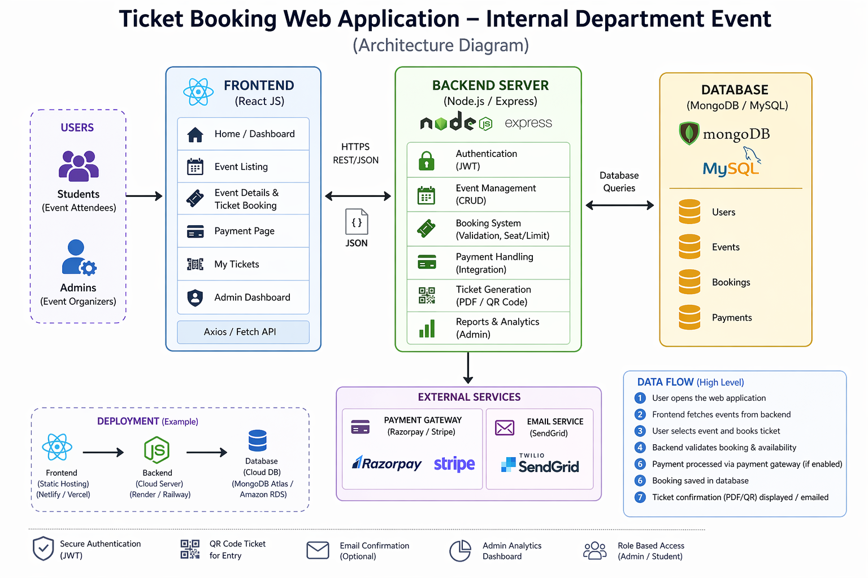
PROPOSED SYSTEM ARCHITECTURE
Input: Users access the application through a web interface to enter login details, browse, and submit registration information events.
Processing: The system processes user requests through controllers and applies business logic such as user authentication, event creation, seat availability checking.
Database: All data is securely stored in a MySQL database, including user details, event information, and registration records, ensuring efficient data storage .
Output: The system displays results through web pages, including available event lists, successful booking confirmations.
1
2
3
4
5
6
7
8
9

Slide 7
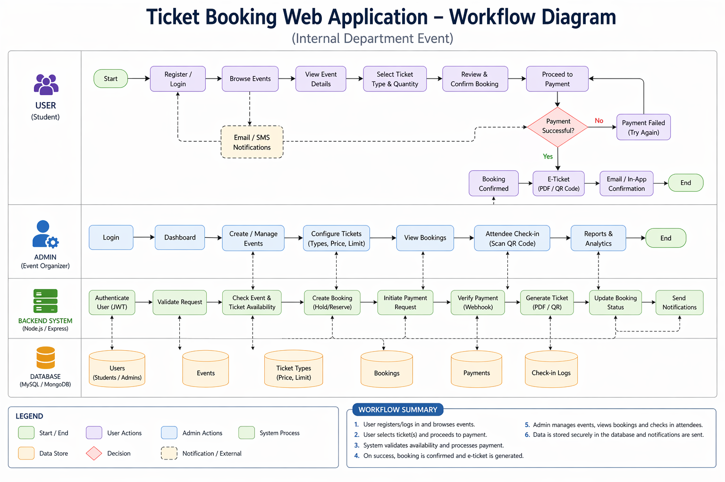
WORKFLOW
1
2
3
4
5
6
7
8
9

Slide 8
TECHNOLOGIES USED
Frontend:
• React JS • HTML, CSS, JavaScript
Backend:
• Node.js with Express.js
Database:
• MySQL
Tools:
• VS Code • MySQL Workbench • Git & GitHub
Hardware/Software Requirements:
• Minimum 4GB RAM • Windows/Linux OS • Node.js & MySQL installed • Web browser • Internet connection
1
2
3
4
5
6
7
8
9

Slide 9
MODULE DESCRIPTION
Module 1:
Handles user registration, login, and authentication..
Module 2:
Displays events and allows users to book tickets.
Module 3:
Stores user data, event details, and bookings securely.
Module 4:
Generates reports on bookings and participant details.
1
2
3
4
5
6
7
8
9

Slide 10
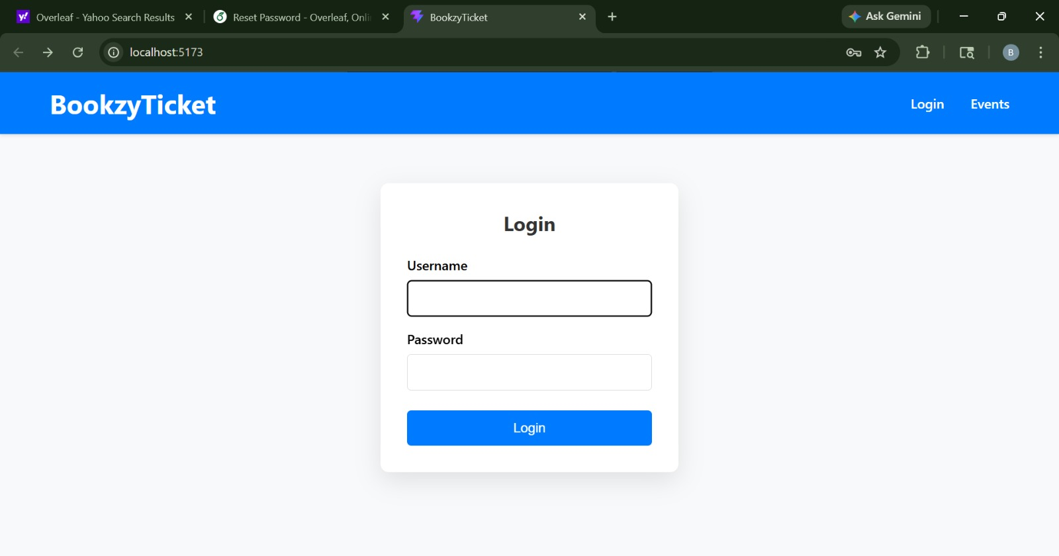
IMPLEMENTATION SCREENSHOTS
1
2
3
4
5
6
7
8
Figure 1 : Home Page
9
The Figure 1 The home page serves as the main interface for users to access the system

Slide 11
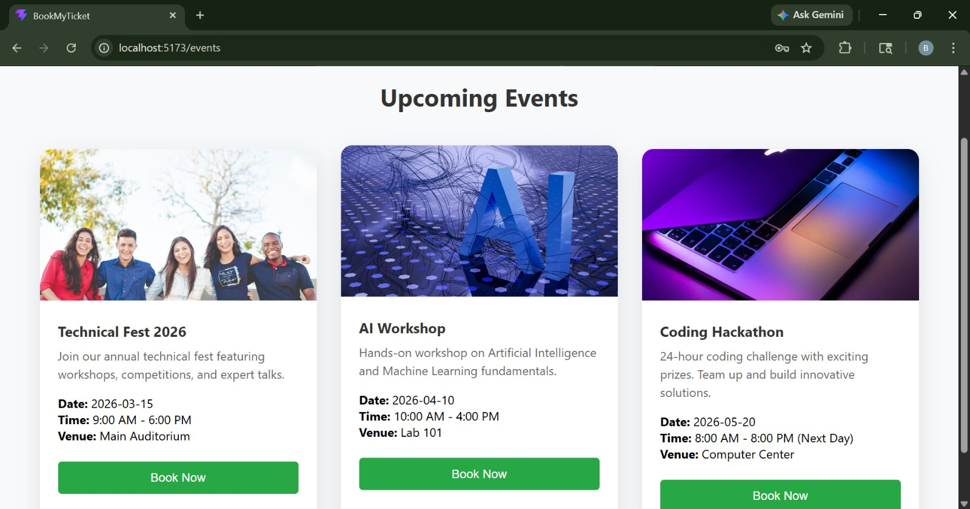
IMPLEMENTATION SCREENSHOTS
1
2
3
4
5
6
7
8(A)
9
Figure 2 : Explore Events Page
The Figure 2 This section displays a list of upcoming events available for users.

Slide 12
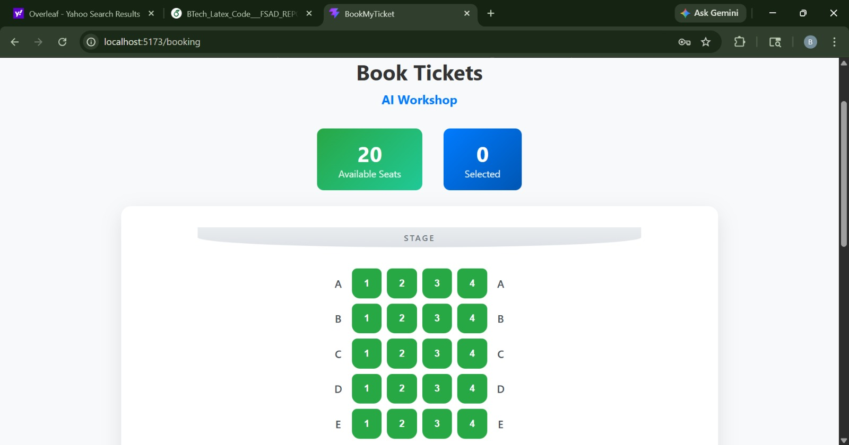
IMPLEMENTATION SCREENSHOTS
1
2
3
4
5
6
7
8(B)
9
Figure 3 : allotment
The Figure 3 This section displays the seating allotment for registered users. It shows the assigned seats

Slide 13
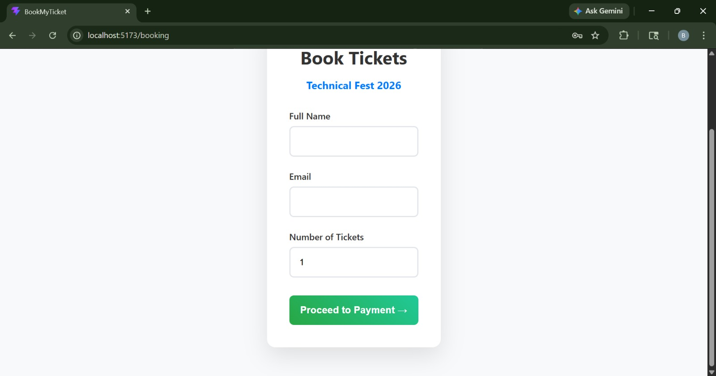
IMPLEMENTATION SCREENSHOTS
.
1
2
3
4
5
6
7
8(C)
Figure 4 : Filling Details
9
The Figure 4 Users fill in details such as name, contact information, and other necessary fields

Slide 14
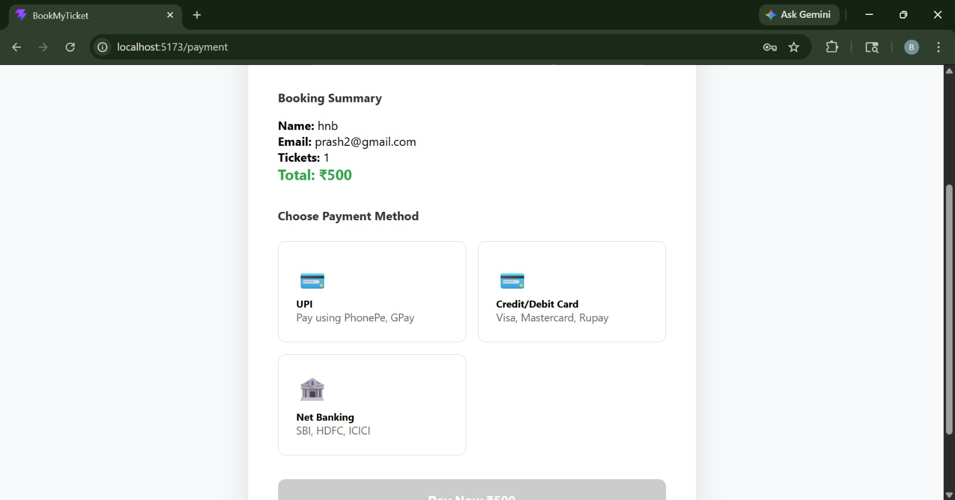
IMPLEMENTATION SCREENSHOTS
Module 2 Screenshot
Explain in 1–2 lines.
1
2
3
4
5
6
7
8(C)
9
Figure 5 : Payment Description
This Figure 5 This section enables users to complete the payment process for event registration. It displays the payment details and available payment options,

Slide 15
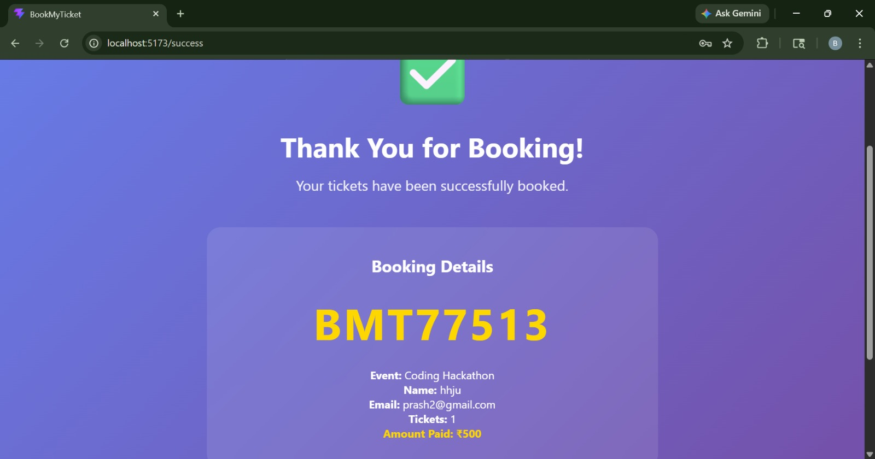
IMPLEMENTATION SCREENSHOTS
1
2
3
4
5
6
7
8(C)
9
Figure 6 : Sucessful Booking
The Figure 6 This section displays a message confirming that the event has been successfully booked

Slide 16
ADVANTAGES & LIMITATIONS
ADVANTAGES
Centralized platform for managing all events
Reduces manual work and human errors
Easy access to event details anytime
Quick and simple registration process
Instant booking confirmation
Efficient tracking of participants
Better event management and organization
Saves time for users and organizers
Improves communication
User-friendly interface
LIMITATIONS
Requires stable internet connection
Initial setup needs technical knowledge
Possible security risks if not properly managed
May be difficult for non-technical users
System failures can affect access
Requires regular maintenance.
1
2
3
4
5
6
7
8
9

Slide 17
Thank you

